Slide 1
Ourisman Automotive
Storage System
Graeme Dickerson-Southworth
Benjamin Summers
Christopher Yue
Mohamed Abdelmagid

Slide 2
Table of Contents
Background
Design and Implementation
Changers and Final Implementation
Demo

Slide 3
Background
Ourisman Automotive is a car dealership franchise
team of 4 at the company manage ALL electronic devices for our dealerships including computers, peripherals, etc
They need a system that will aid them in managing all of the equipment for where and when it gets used.
The system will allow them to update and keep track of their inventory

Slide 4
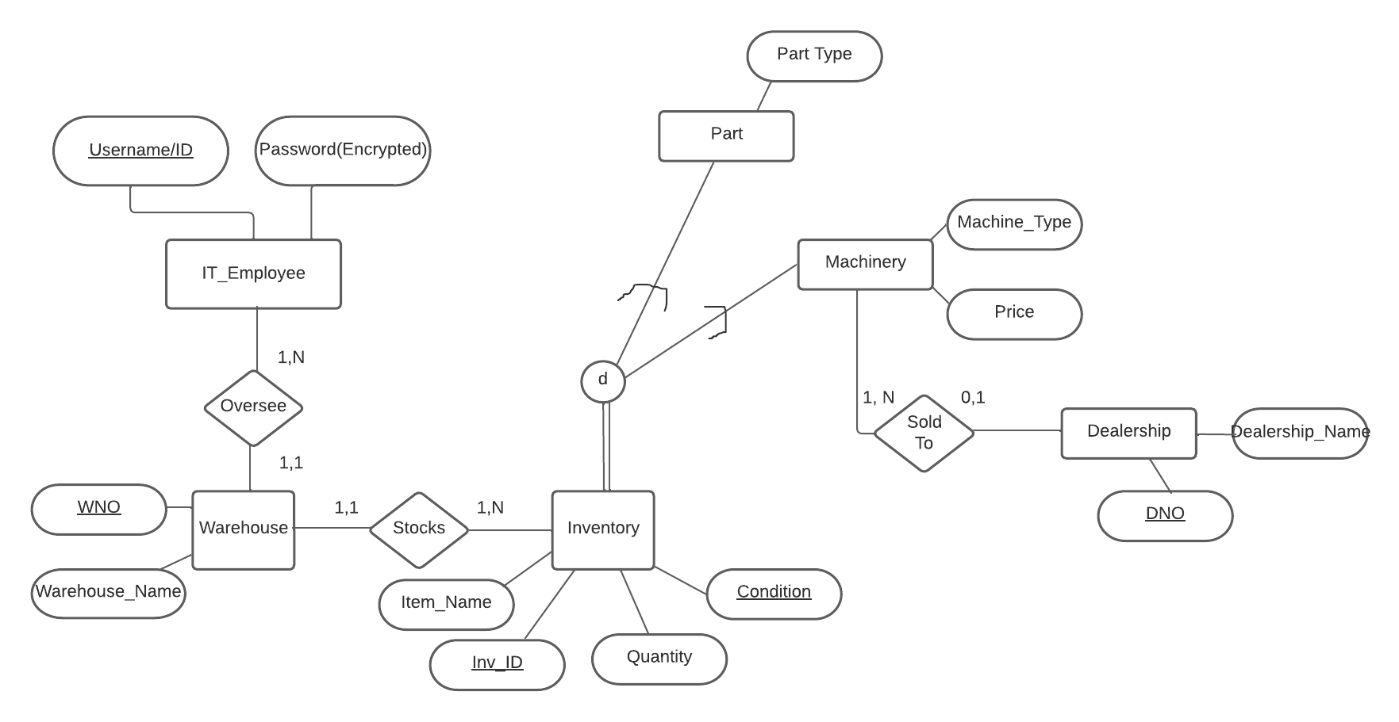
Design And Implementation
Designed initial ERD and schema based on requirements given by representative
Created database with MySQL
Created GUI with Netbeans

Slide 5
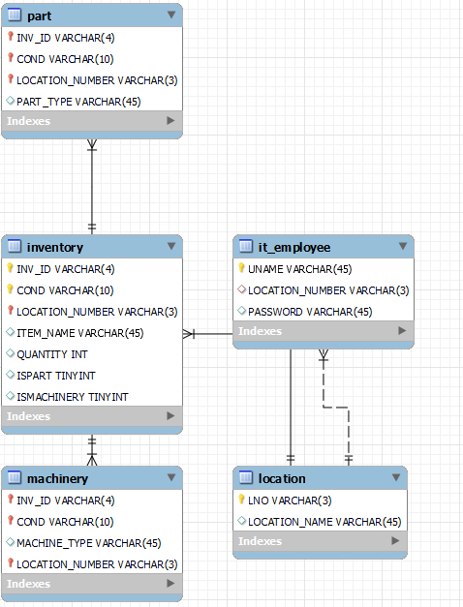
Changes and Final Implementation
Used Java Netbeans To Build Front-end
Framework
Dropped dealership table and merged
with warehouse to make locations table
Discussed with representative to drop price
attribute for machinery
Prefer to focus more on strictly inventory

Slide 6
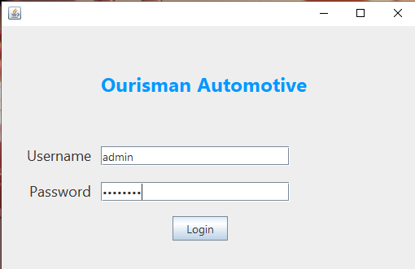
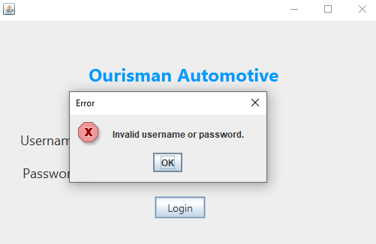
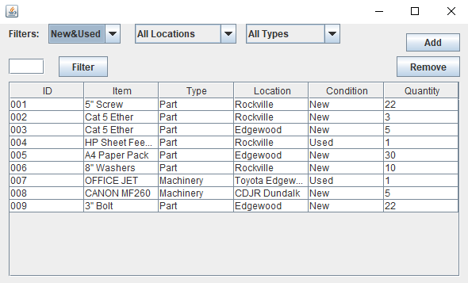
Demo
Start Screen: Login Screen
Checks DB for
Username/Password
Raises Error if match
not found
Opens Inventory Screen

Slide 7
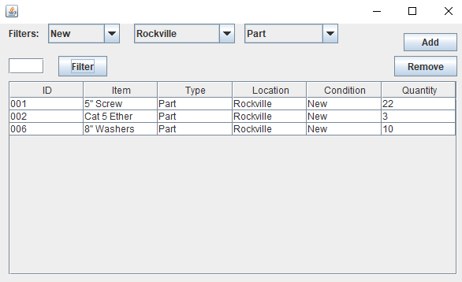
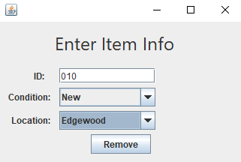
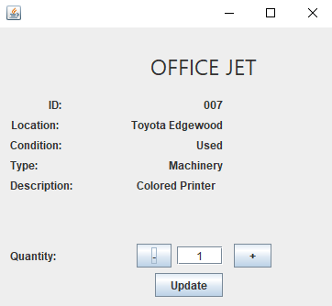
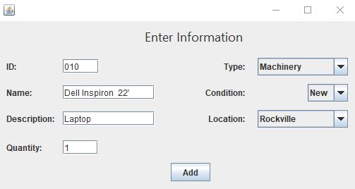
Demo Cont.
Added filters
search convenience
Buttons/Pop Ups to
add/remove inventory
Clicking on a field Allows you
to update it’s quantity

Slide 8

Demo Video

